Slide 1









Nurture: Autonomous Plant Care System
sddec24-16
Cameron Jones, Chase O’Connell, Cayden Kelley,
Blake Hardy, Tejal Devshetwar, Holden Brown
Advisor: Md Maruf Ahamed
Notes:
Cameron

Slide 2



Product Need + Goals
Convenience:
Eliminates Guesswork (watering, fertilizing).
Automates Critical Tasks.
Accessibility:
Empowers beginners
Affordable Design
App Remote Monitoring
Reliability:
Consistent Real-Time Care
Reduced Human Error
Scalability:
Adaptability to different plant types and growing conditions.
Notes:
-Too wordy. Reduce.

Slide 3
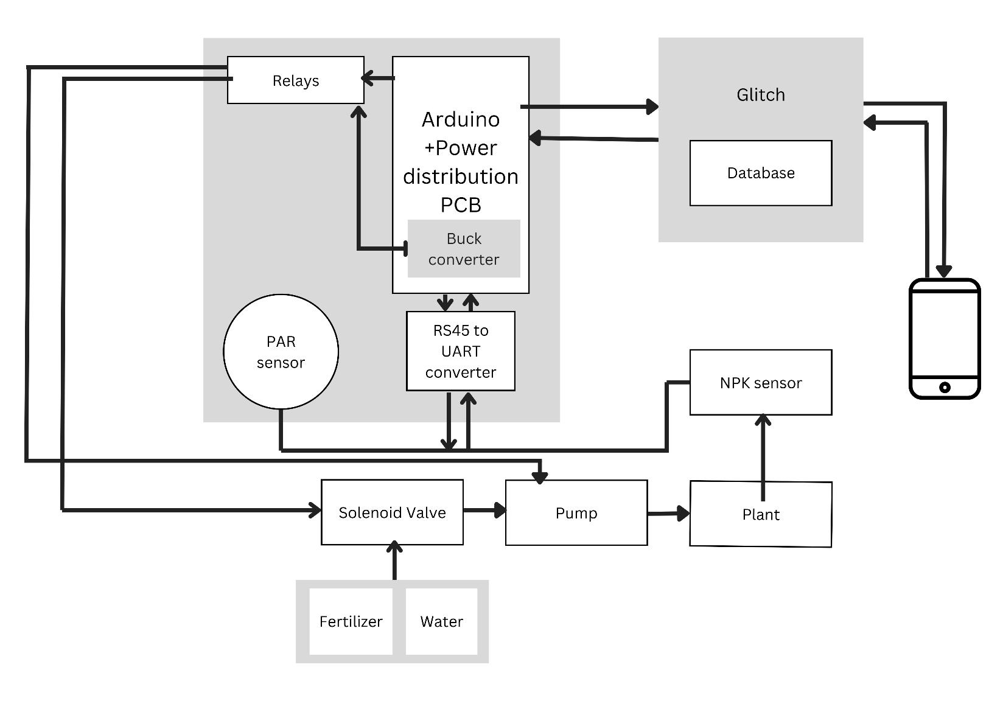
Project Overview
Notes:
Cameron

Slide 4
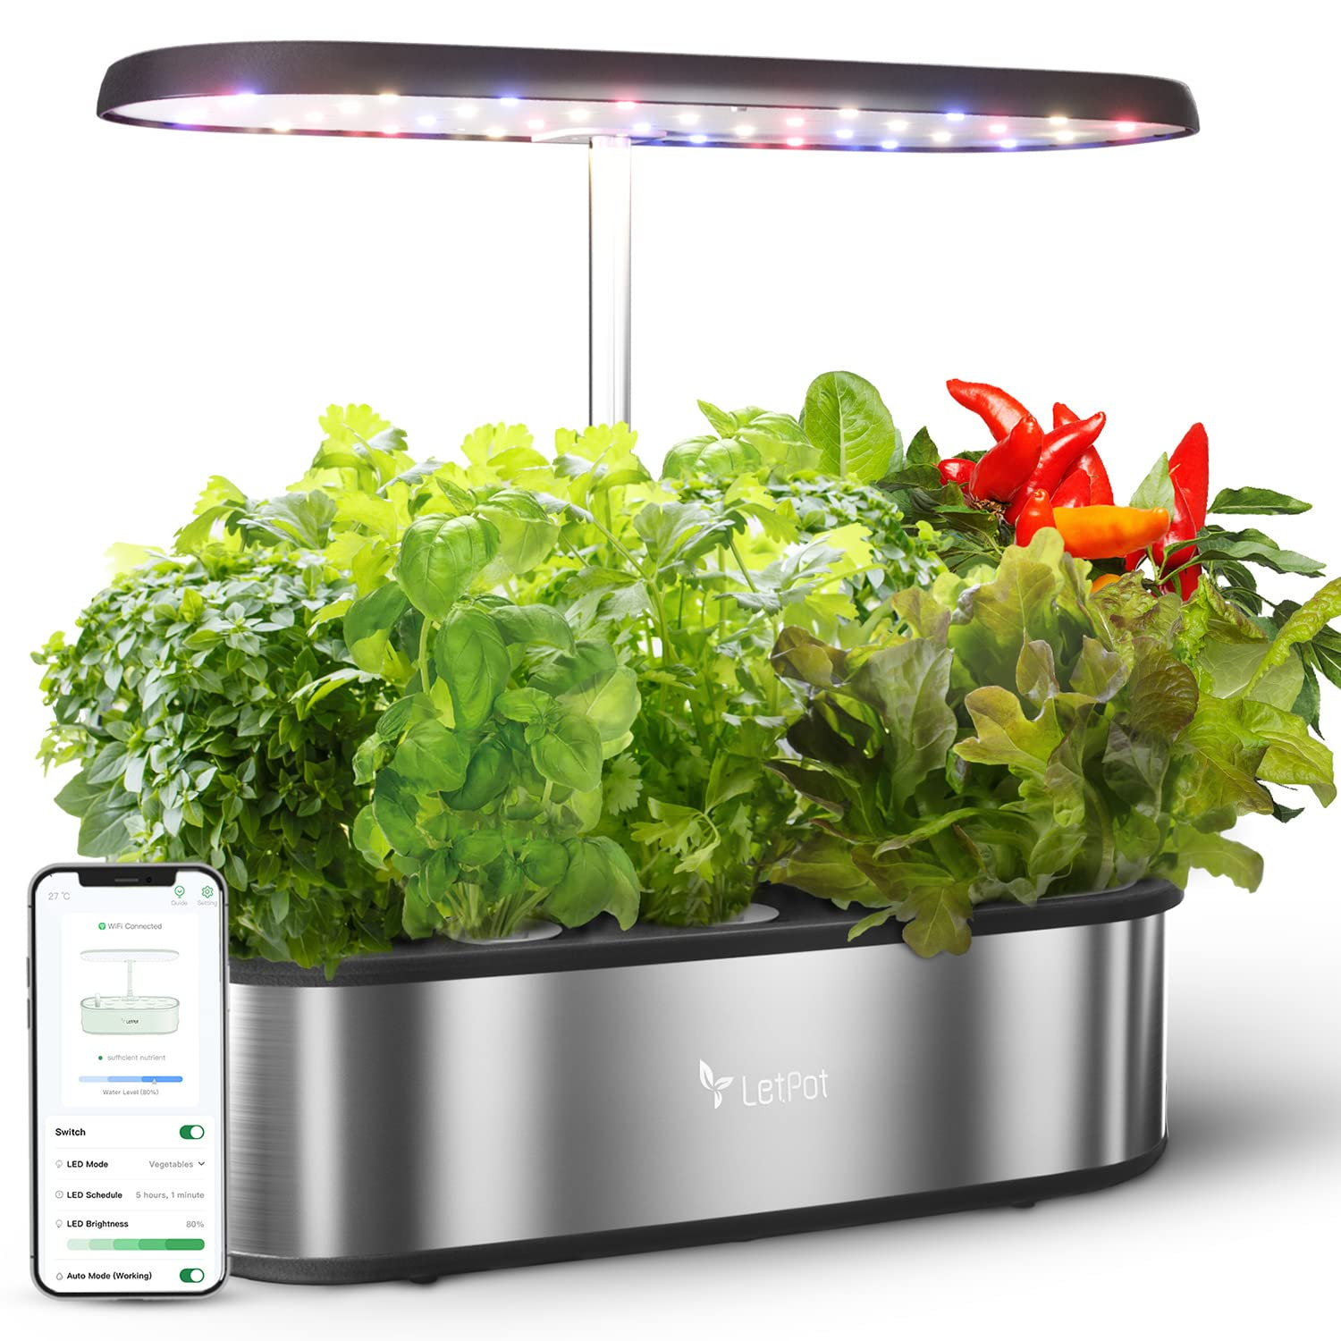
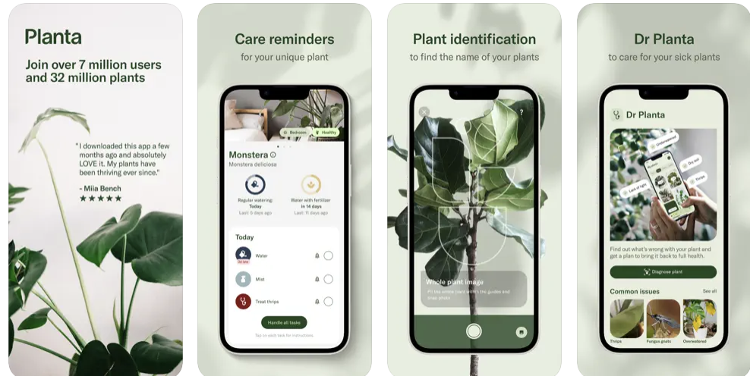
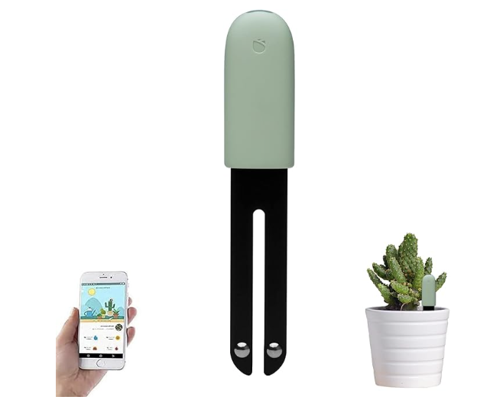
Market Research
LetPot
Planta
Sinbeda

Slide 5
Product Comparison
 | Sensor Connectivity | Soil Moisture Monitor | Soil Nutrient Monitor | Automated Watering and Fertilizing | Plant Care Recommendations
LetPot | Bluetooth | No | No | Watering | No
Planta | No Sensor (Camera) | No | No | No | Yes
Sinbeda | Bluetooth | Yes | Yes | No | Yes
Our Design | WiFi | Yes | Yes | Yes | Sensor-Based Recommendations

Slide 6








Hardware
Design

Slide 7
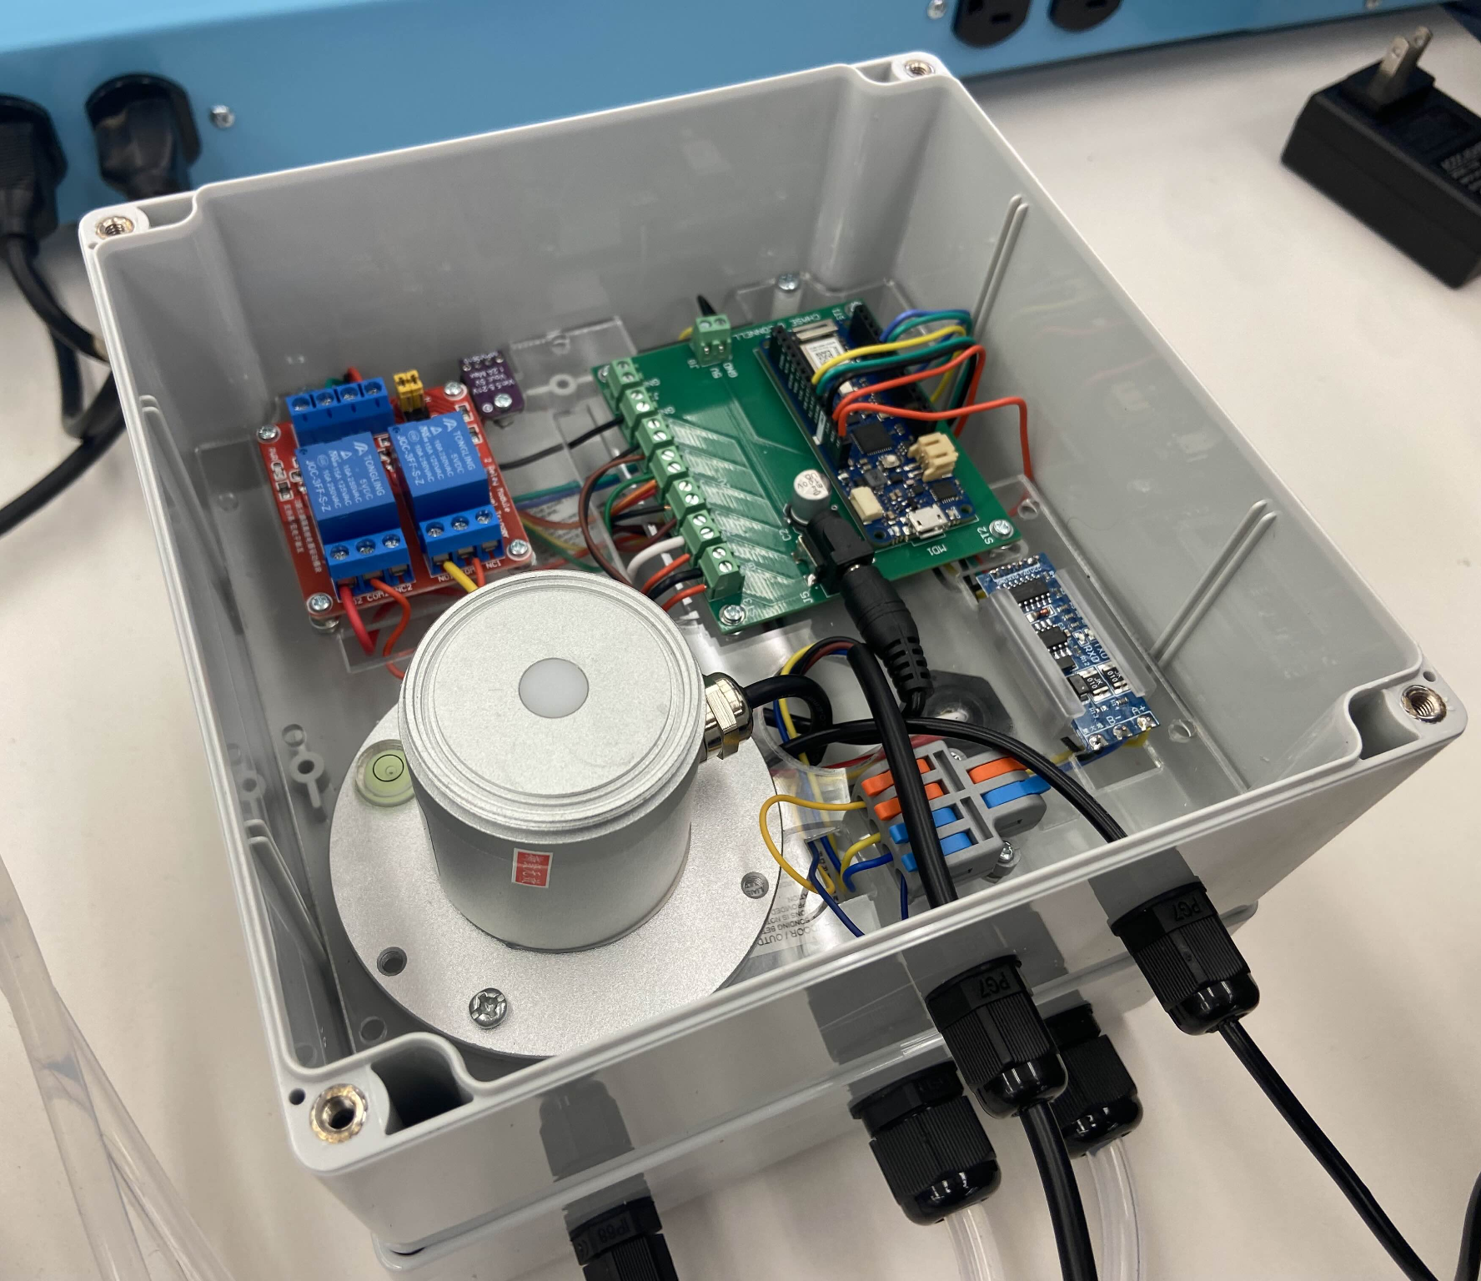
Hardware Requirements
Resources:
Power: AC Adapter
Liquid System: Pump, Solenoid Valve, Pipes
Sensors: Soil Metrics, Light
General: Microcontroller, IP68 Enclosure
Functional:
Working automated liquid distribution.
Sensor data transmission.
Non-Functional:
Size: 3+ inch diameter pot compatibility.

Slide 8
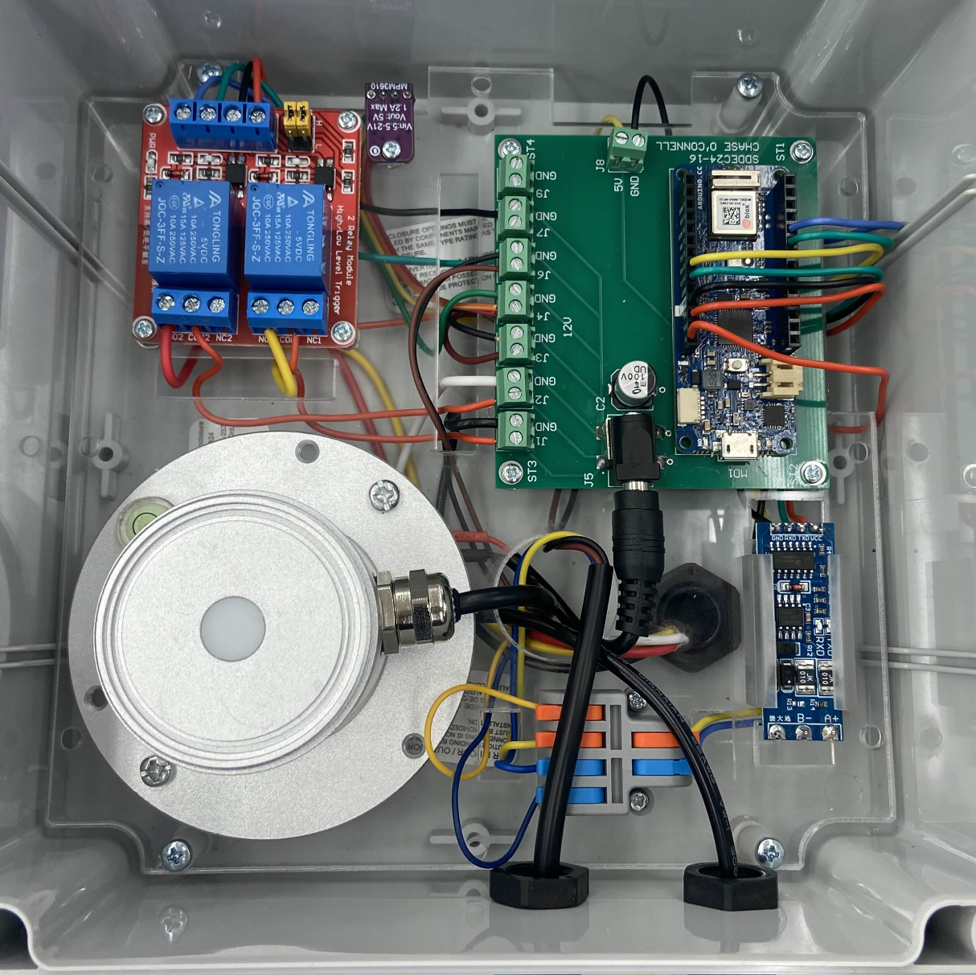
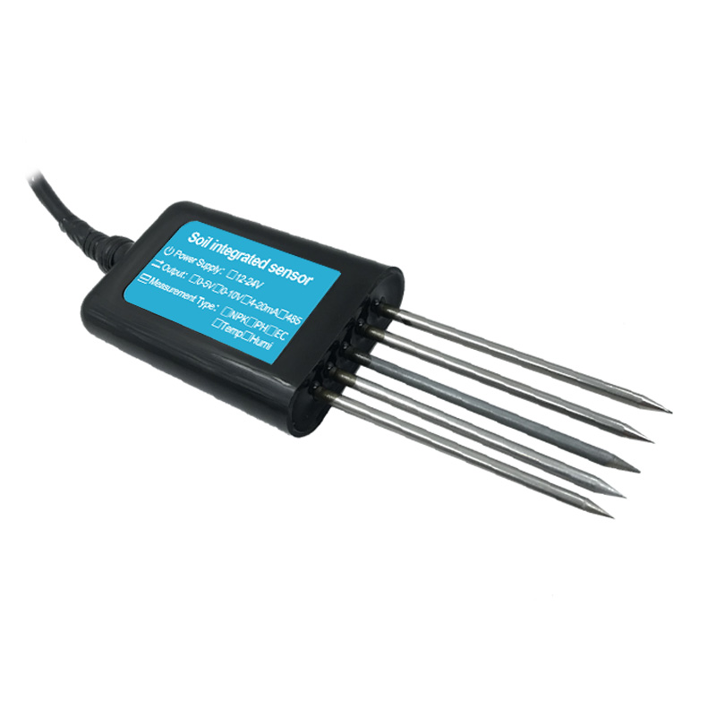
Hardware
RS485 To UART Converter
PAR Sensor
Dual Relay
PCB
Buck Converter
Arduino Mkr Wi-Fi 1010
7 in 1 Soil Sensor

Slide 9
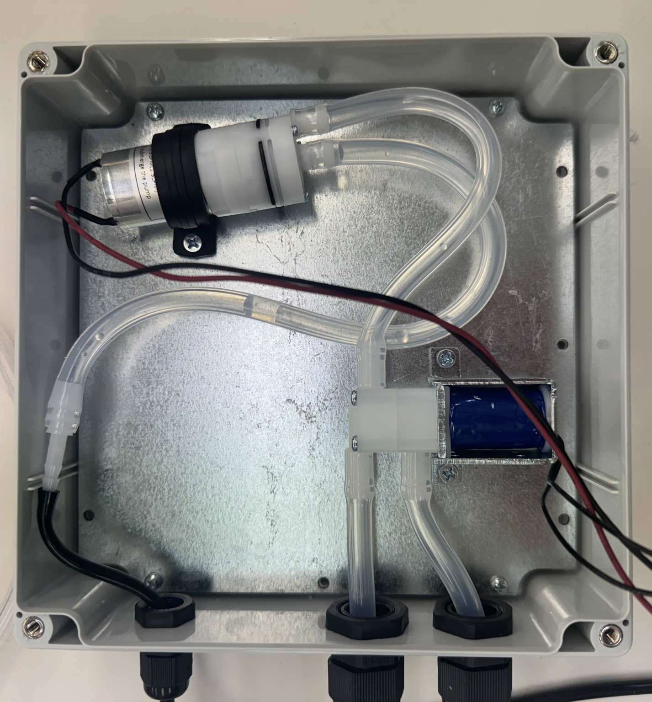
Hardware
Inputs: Water (Right) & Fertilizer (Left)
Pump
Solenoid Valve
Output (Water or Fertilizer)

Slide 10
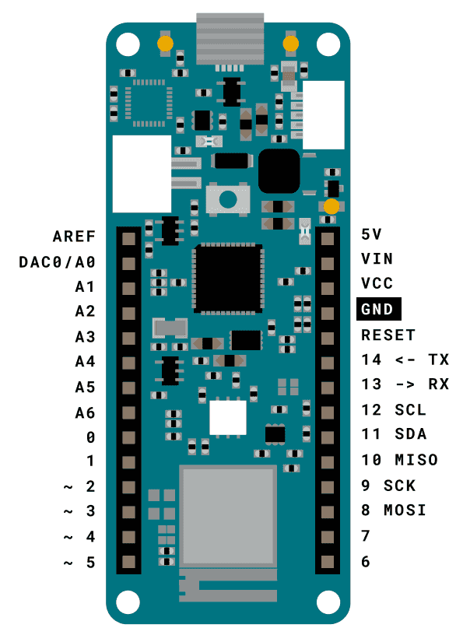
Microcontroller
Arduino MKR Wi-Fi 1010
Low Power
Small Form Factor
Great Library Support:
Modbus
WIfinina + HTTP
Low-Power
FreeRTOS
Wi-Fi Capable - Server Communication
Sensor Data Handling
Format and send NPK + PAR data

Slide 11
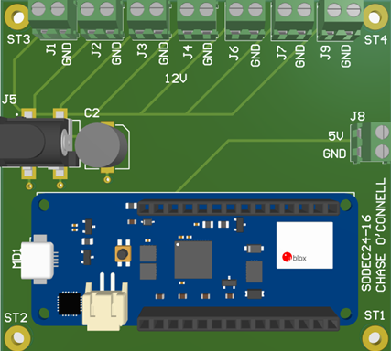
PCB Design
General:
Altium Designer
Power Distribution to All Peripherals
Time, Cost, Integration
Design:
2-Layer:
Top: 12V and 5V Power Traces
Bottom: GND Polygon Pour
Components:
Terminal Blocks - Peripherals
Barrel Jack + Bulk Capacitor
Arduino Footprint - Mounting

Slide 12
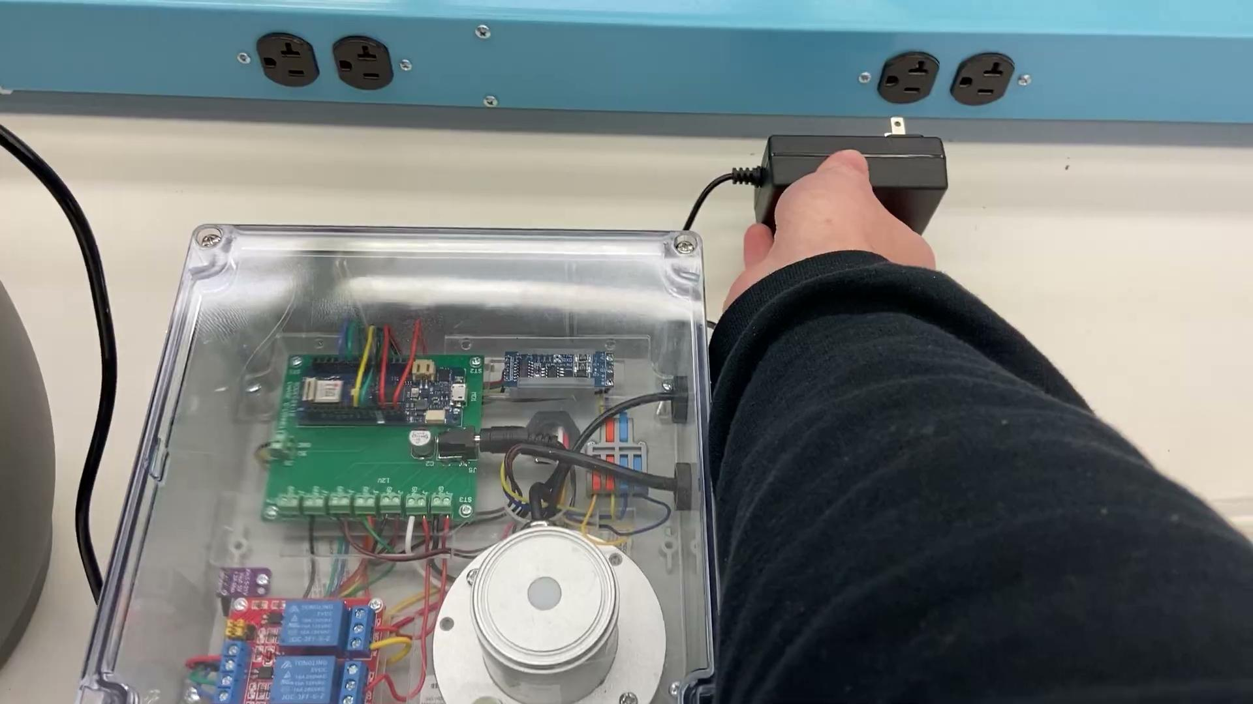
Hardware Demo

Slide 13
Software
Design

Slide 14




Software Requirements
Resources:
Development Tools: React Native, MongoDB, Node.js
Server: Glitch
Functional:
UI: Graphical & Numerical Data, User Plant Creation + Viewing Pages
UX: Reliable (no crashes, freezing), App Synchronization, Stored User Plant Data
Non-Functional:
Backend: >99% Uptime, Secure
Codebase: Modular

Slide 15
Software Overview
Frontend: App
Developed with React Native
Displays sensor data graphically.
Plant and user management
Backend: Express, Mongoose, and MongoDB
Node.js: communication between the database and app.
MongoDB: stores user data
Nested schema for easy management
Key Technologies:
Unified JavaScript stack for backend and frontend
Asynchronous programming model

Slide 16
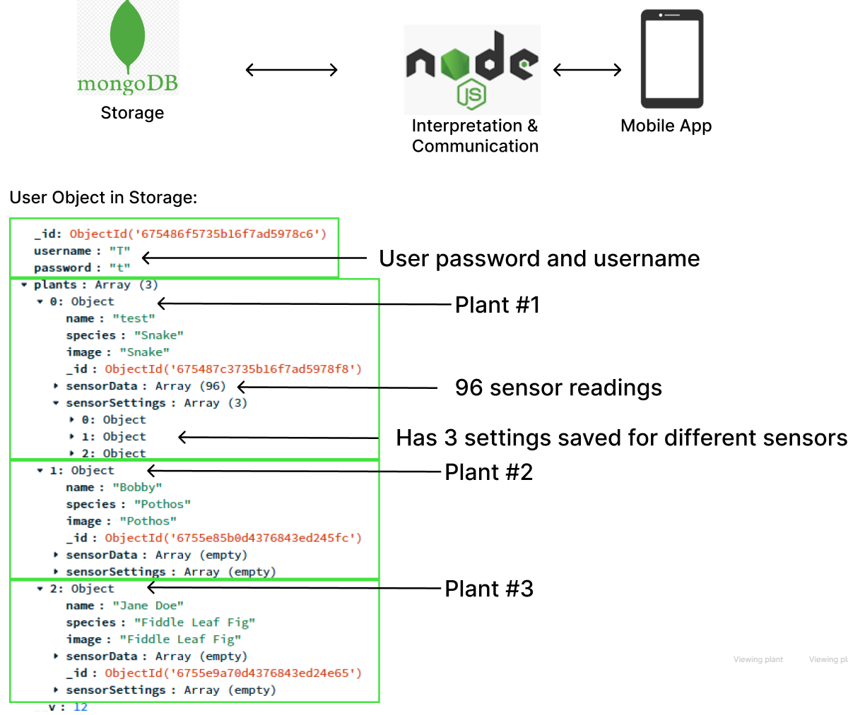
Visual Overview

Slide 17
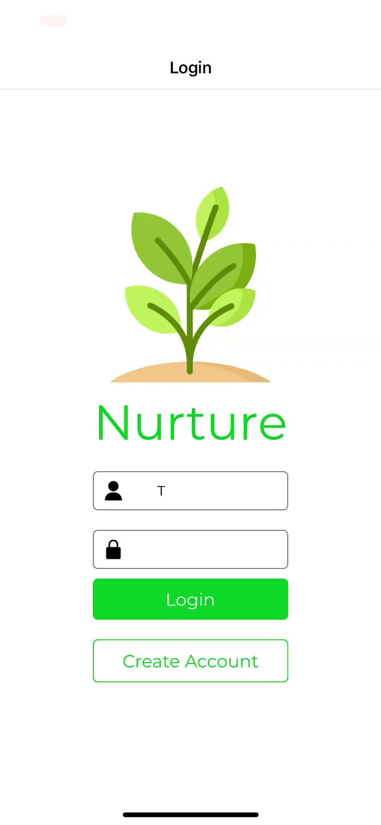
Mobile App Demo

Slide 18
System Analysis

Slide 19
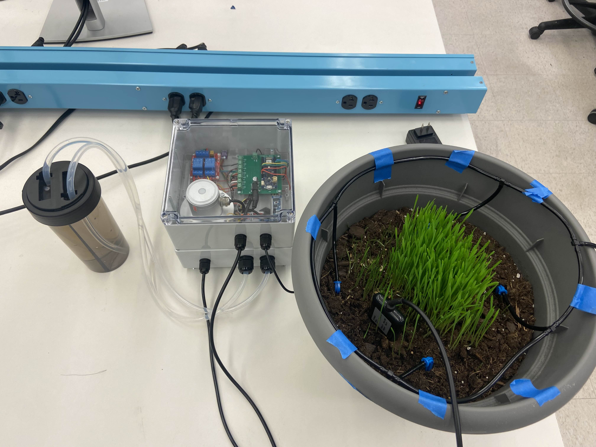
Risks and Mitigation
Risks:
Liquids interfere with electronics
Selected sensors do not integrate
Database data is lost
Mitigation:
Waterproof enclosure selection
Isolated pump and reservoir system
Thorough sensor research
Select well-documented components
Compare voltages, protocols, etc.
Perform regular data backups

Slide 20
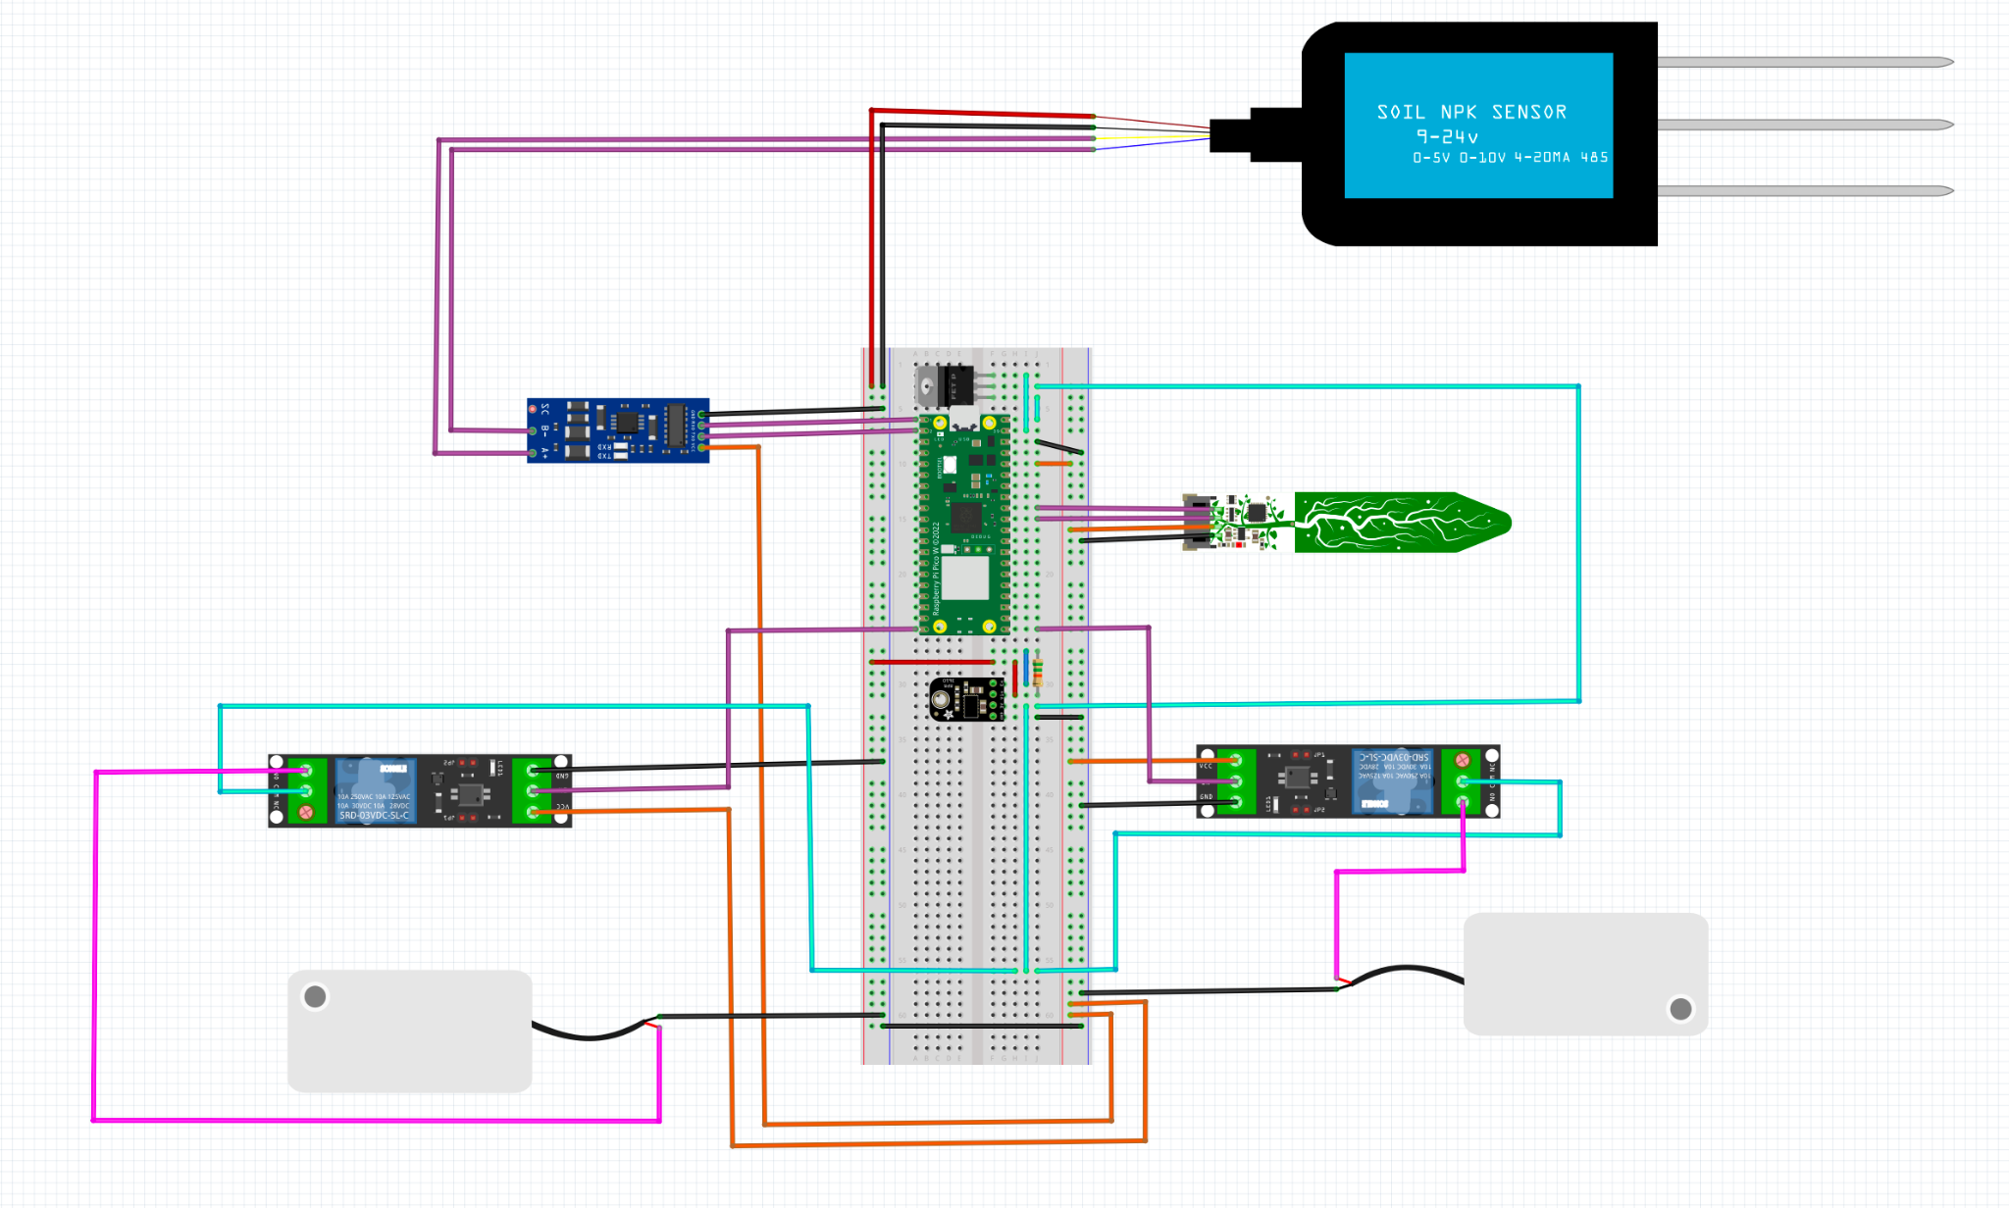
Hardware Challenges
Initial Iteration:
Pi Pico: $6
Limited Soil Sensor
Final Iteration:
Arduino MKR Wi-Fi 1010
Enclosure
Pump + Valve System
Removed Redundant NPK Sensor
Custom Power Board

Slide 21
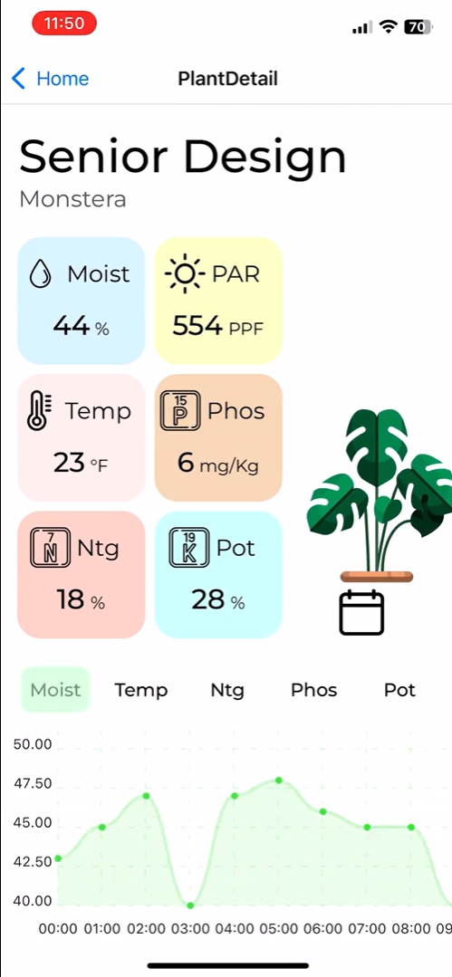
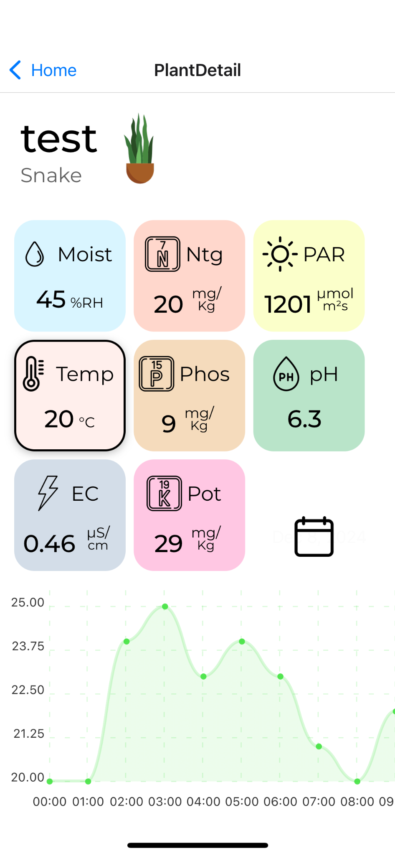
Software Challenges
Keeping the database and mobile app synced
Backend data validation
Boxes displaying values for sensor data act as buttons for displaying graphical data for that sensor.
Updating the plant image on correctly based on the user plant.

Slide 22
Testing

Slide 23
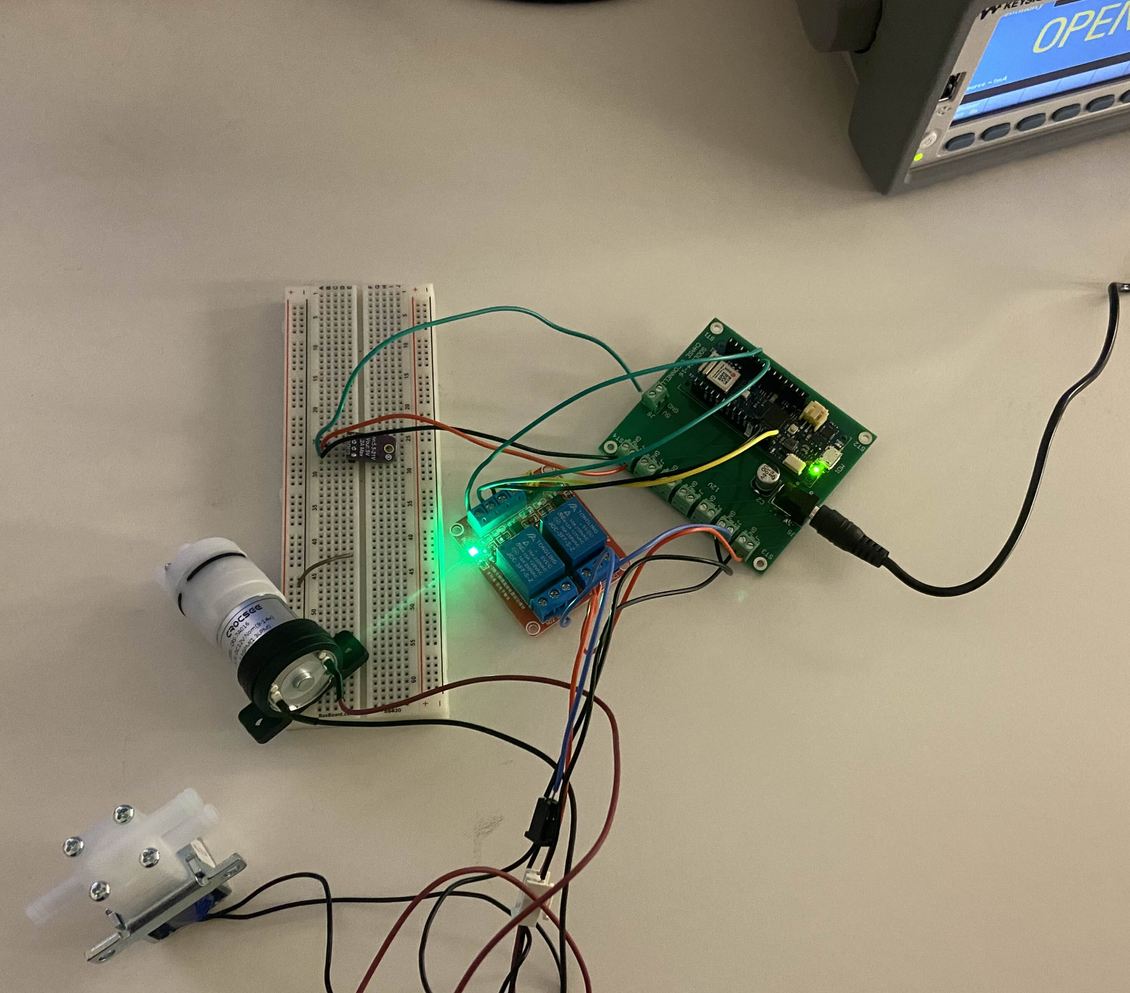
Testing Procedure
Approach: Isolated unit testing with gradual system integration.
RS485 (Modbus) Sensors:
Responsive TTL Converter
Arduino Serial Monitor to check raw data.
PCB:
Multimeter - checking voltages, peripheral functionality.
Mobile App Backend:
Postman “post” and “put” commands to update database.

Slide 24
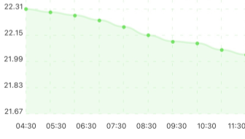
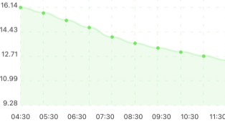
Test Results + Conclusions
Soil Moisture (RH):
Results:
3+ Days of NPK and PAR sensor data
Working liquid threshold system
Complete data transmission pipeline
Conclusions:
PAR Sensor: Required minimum, lower than expected.
Linear decrease of NPK nutrient availability as soil moisture decreases.
Nitrogen (mg/kg):

Slide 25
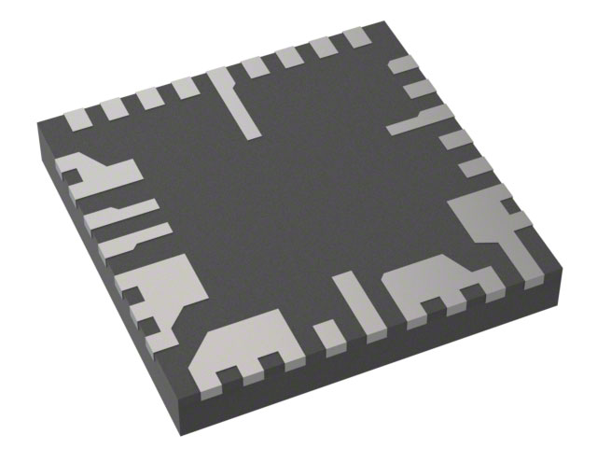
Future Considerations
Software:
Compare NPK threshold values only when in a set moisture range (Ex: 40-50% RH).
Hardware:
Battery-Powered: Outdoor Usage
Longer, Outdoor Capable, AC Adapter Cable
Integration:
Direct server to Arduino communication
Threshold limits: NPK, Moisture
Manual Watering + Fertilization
12V Battery Regulator IC in Consideration

Slide 26








Questions?

